Slide 1

An Attention-Based Video Inpainting Technique for Wire-removal Scenarios
ECE 6258 Group #6 Final Presentation
J. Hou, L. Xu, J. Zhang, and J. Li
Speaker: Lixin Xu
Date: Dec. 7 2021

Slide 2


Problem Statement
In many movies and TV series, metal wires are used to help actors fly
Develop an intelligent model to help people remove wires in the video
Propose an attention-based video inpainting network for wire-removal
Notes:
In order to achieve some visual effects, especially in traditional Chinese Kungfu TV series
Removed manually, which is extremely exhausting and trivial.
Given this scenario, we aim to design an approach that can be used to finish the task naturally and efficiently

Slide 3
Overall Methodology
Datasets
Encoder-decoder architecture
G2L-net (Global to Local) with Transformer
Window-sliding Technique
Quality Assessment
Notes:
Collect Dataset
Encoder-decoder architecture to encode frames to features
G2L-net (Global to Local) follows a similar mechanism to human eyes
Window-sliding Technique for selecting frames with maximum difference
Quality Assessment on certain metrics

Slide 4
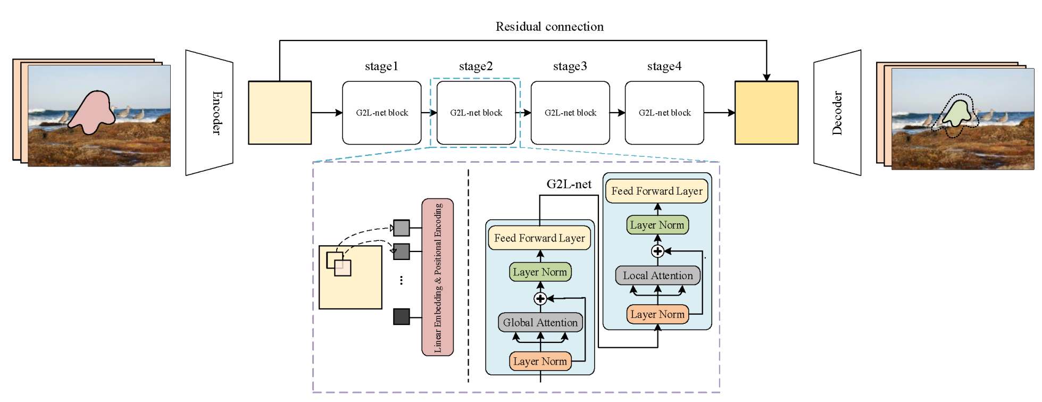
Proposed Model
Notes:
A pair of encoder and decoder
Preprocessing (yellow block)
Divided into four stages, each stage contains a G2L-net that is composed of two transformer models
The first TF deals with Global attention and second local attention.
These G2Ls are connected in series
Decoder transforms the feature map back into video frames.

Slide 5
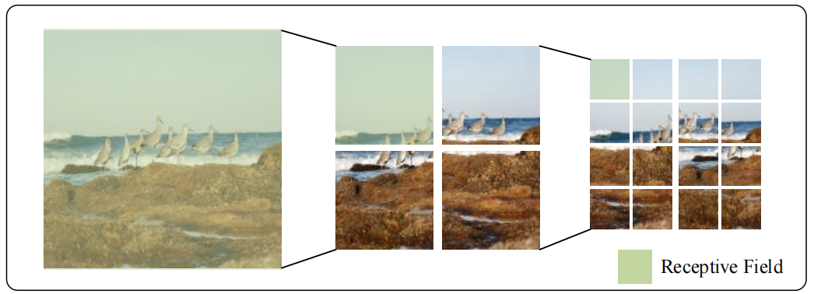
G2L-net
Composed of 2 Transformers
Global Attention
Local Attention
Region of Attention, similar to human eyes

Slide 6
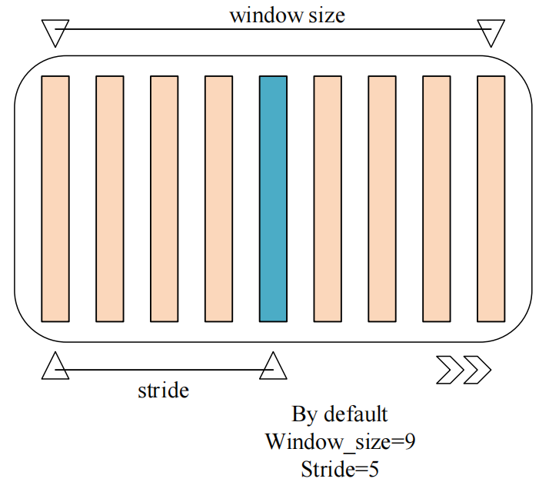
Window-sliding technique
Proposed technique to select frames with maximum difference
Window size
Stride
Slide through time-series
Notes:
Select a frame with a maximum difference to the reference frame,
Contains more information of change
in order to save computation
Window size refers to the num of frames to search from
Stride refers to the steps that the window moves

Slide 7
Improved Onion-peeling Algorithm
Previous [1]
Inpaint a corrupted video frame by frame
Each frame follows a progressive inpainting algorithm
Completed frame will not be used for reference any more
Ours
Inpaint a video clip by clip, which means a series of frames are inpainted in each iteration
The completed video clip will be utilized in the next inpainting iteration.
[1] Oh S W, Lee S, Lee J Y, et al. Onion-peel networks for deep video completion[C]//Proceedings of the IEEE/CVF International Conference on Computer Vision. 2019: 4403-4412.

Slide 8
Experiments
Davis
Collected
Notes:
DAVIS dataset contains 150 high quality video sequences. Although DAVIS is not originally proposed for the evaluation of video inpainting algorithms, it is adopted here because of the precise object mask annotations
We also collected our own dataset from a Chinese TV drama for the experiment

Slide 9
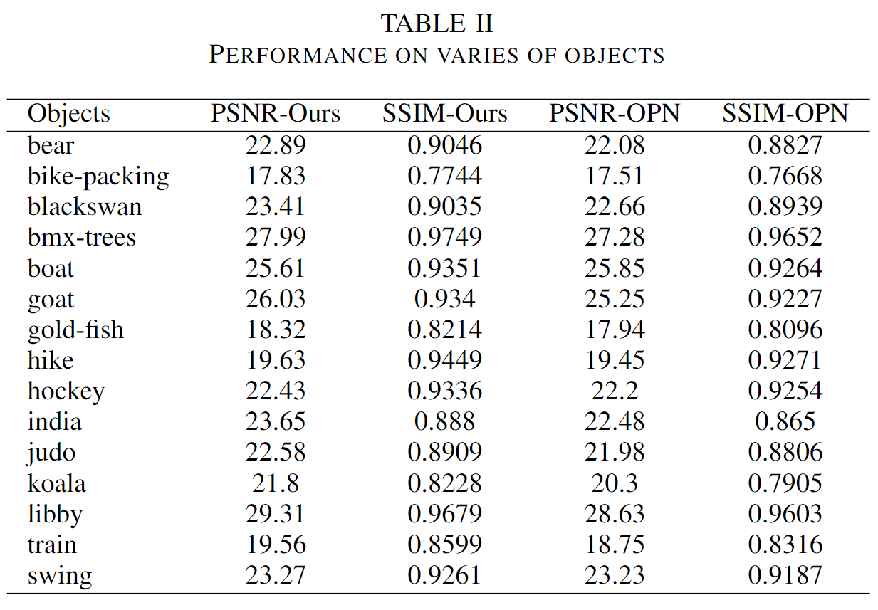
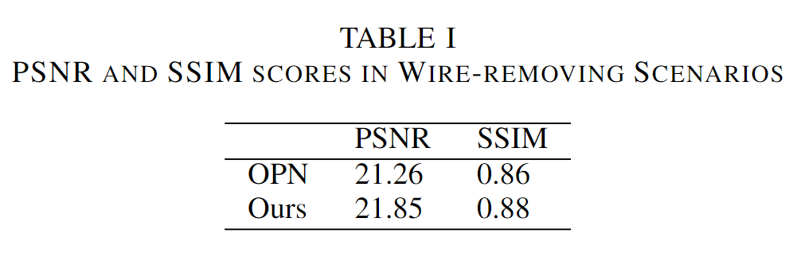
Results Analysis

Slide 10
Conclusion
Come up with model that handles wire-removal scenarios
An improved version of onion-peeling algorithm
Propose a window-sliding algorithm
Testing of performance
Video link to our presentation:
https://drive.google.com/file/d/10WcyiTCV5Enb6q3EFI16kHMm8pIUQbjr/view?usp=sharing

